Slide 1
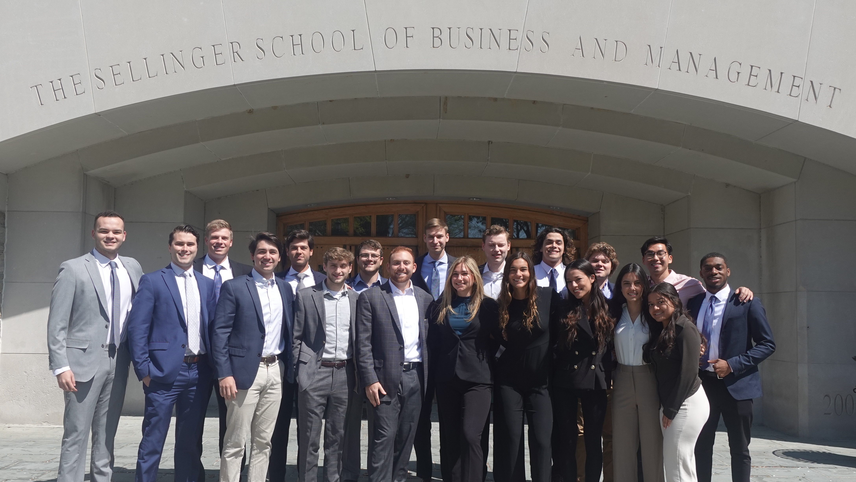
Meet The Class

Slide 2
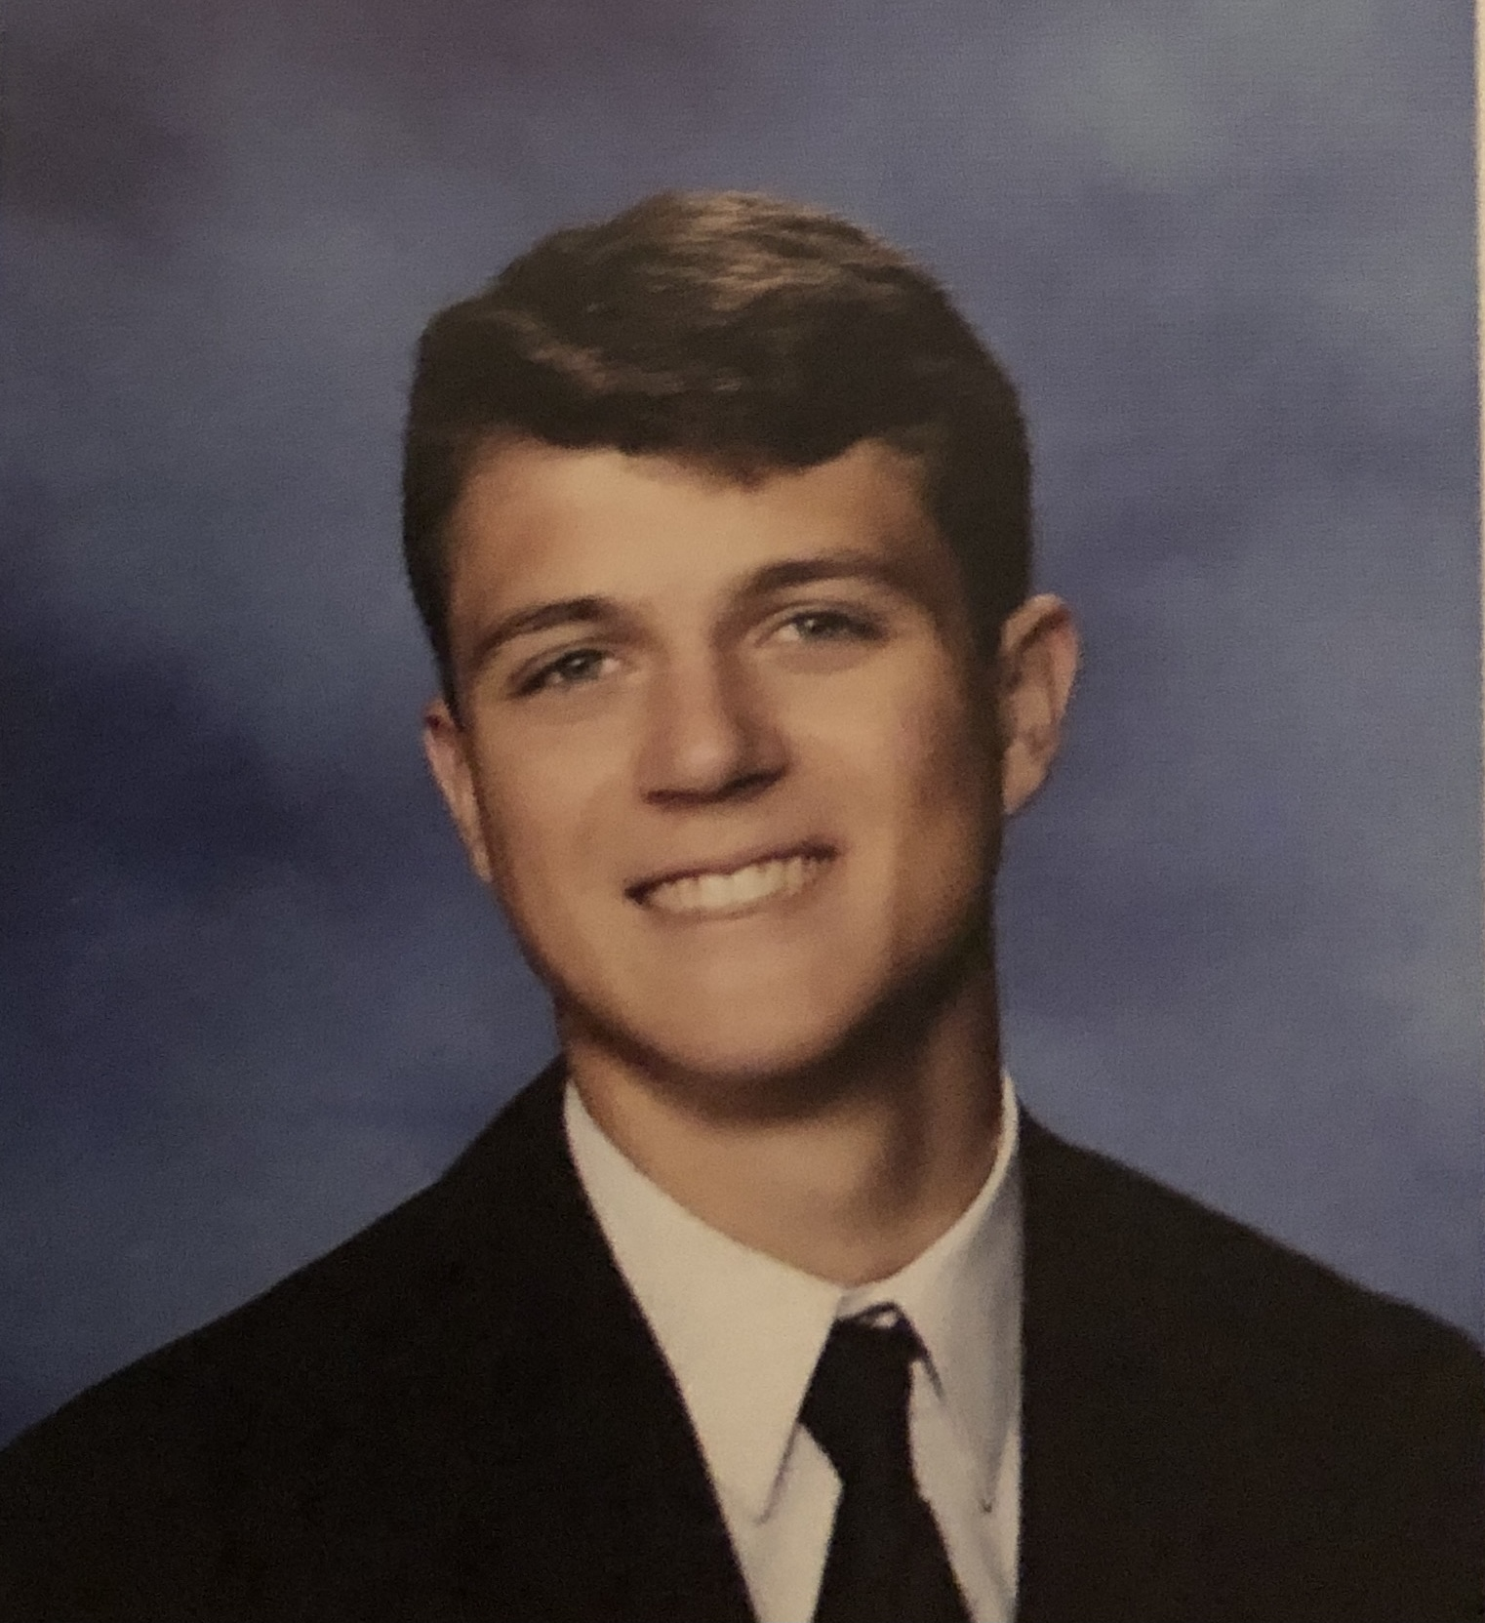
Sean Apostoli
Sean is an undergraduate student pursuing a Bachelor of Business Administration with a concentration in Finance at Loyola University Maryland. In addition to his studies, Sean is the Captain and President of the Loyola Club Baseball team. He has previously interned for Northwestern Mutual as a Financial Representative Intern and is currently a member of the analytics team for UMBC Baseball. Following graduation, Sean will be pursuing a career in consulting as an Advisory Associate at Baker Tilly in his home state of New York.

Slide 3
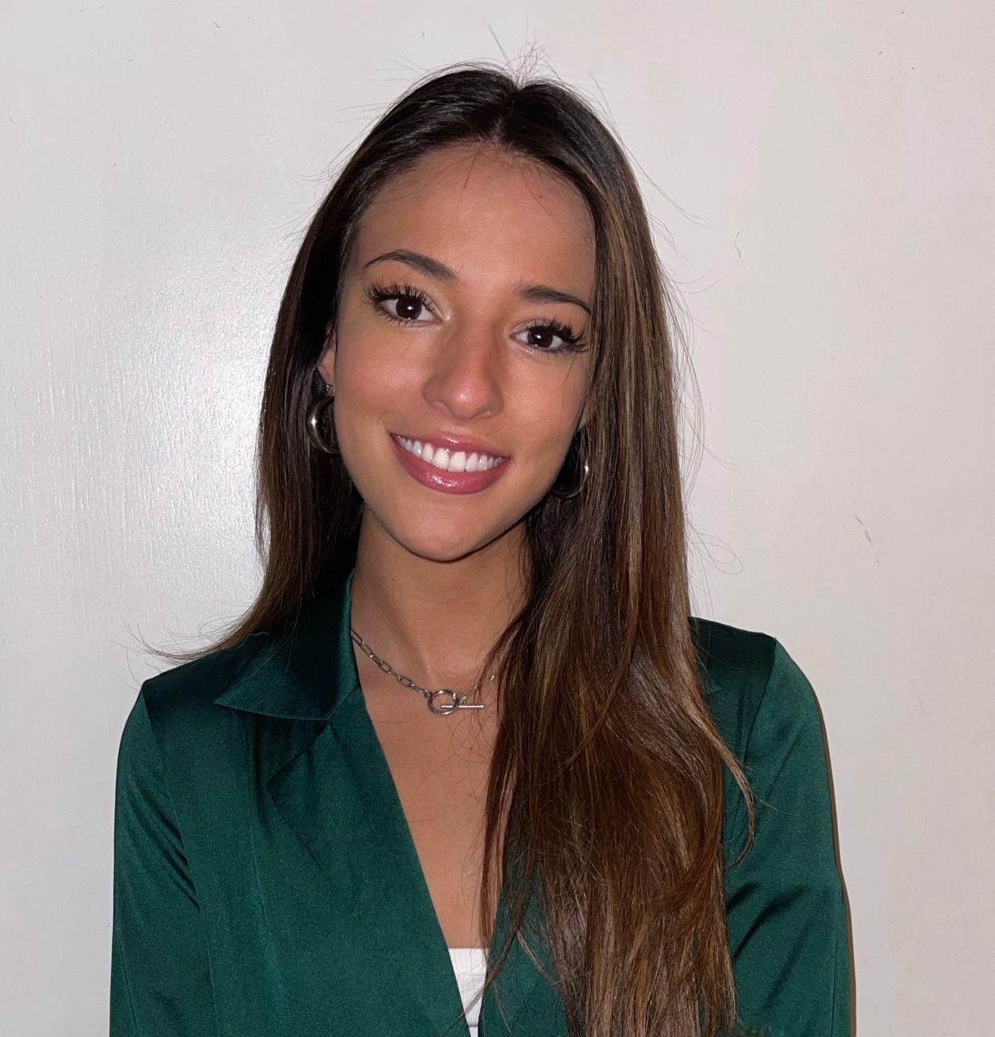
Valentina Bastidas
Valentina is an undergraduate student pursuing a Bachelor of Business Administration with a concentration in Finance at Loyola University Maryland. Valentina has previously interned at Morgan Stanley as a Summer Financial Analyst in the Institutional Securities group. Apart from her studies, she is a member of the Financial Management Association at Loyola and mentors first-generation Latinx high school students. Following graduation, she will return to New York City and work at Morgan Stanley as a Full-Time Financial Analyst.

Slide 4
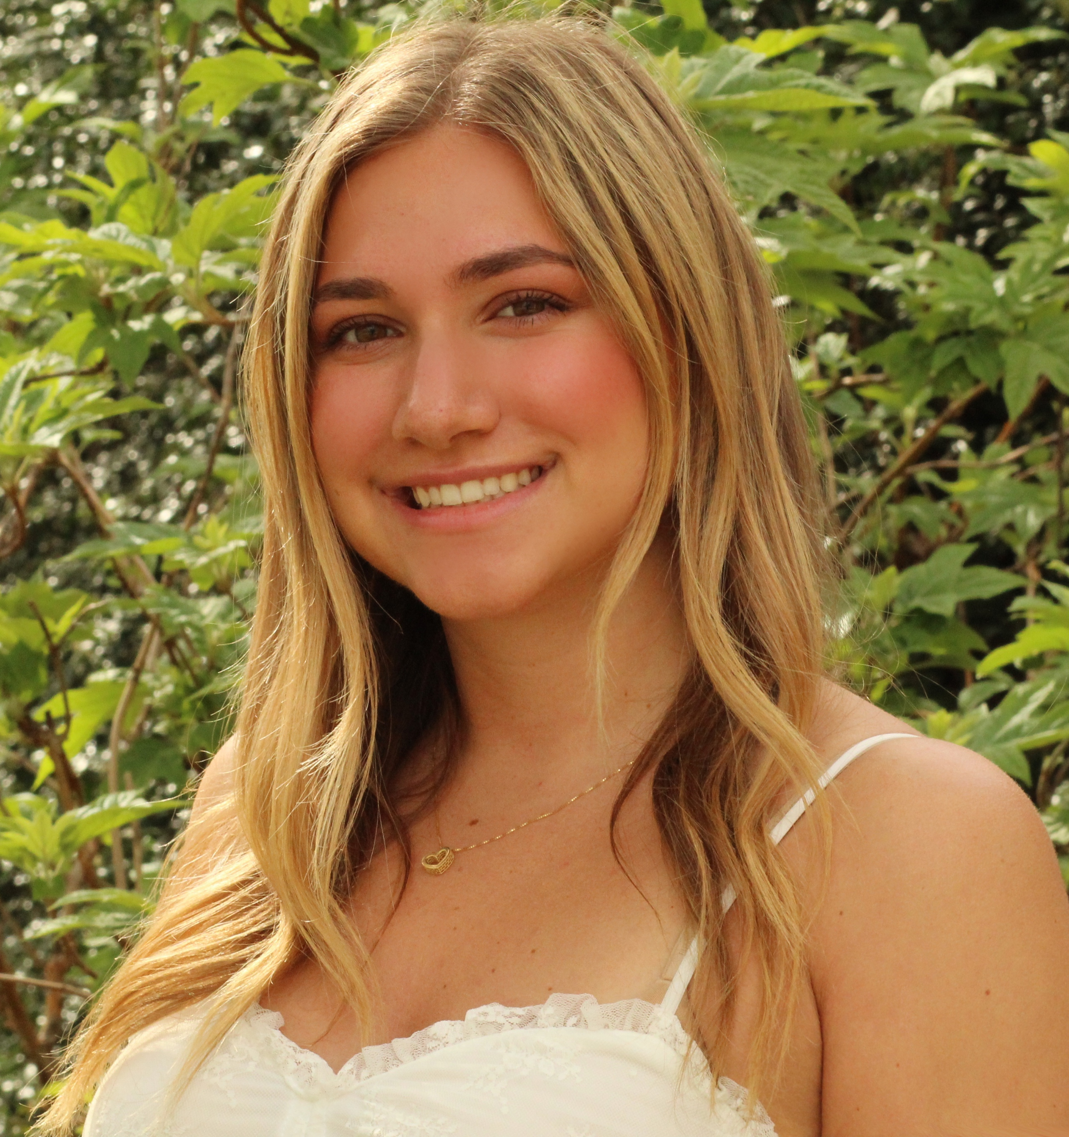
Madison Burns
Madison is an undergraduate student pursuing a B.B.A with a concentration in Finance and a dual minor in Information Systems and Writing. Madison serves as Chair of Recruitment for the professional business fraternity Alpha Kappa Psi and as a member of the Financial Management Association. She spent the past summer as a Business Development intern at Agilis Advisors, an advisory firm operating out of Berlin, Germany. After graduation she will join SC&H Group in Baltimore working in System and Organization Controls to assist clients with cybersecurity assessment, data privacy support, and internal control consulting services.

Slide 5
Giovanna Concalves
Giovanna is an undergraduate student pursuing a Bachelor of Business Administration in Accounting and Bachelor of Business Administration with a concentration in Finance at Loyola University Maryland. In addition to her studies, she is also a member of Beta Alpha Psi and participated in other clubs on campus as well. This past summer she interned at Cornerstone Building Brands, a manufacturing company in New Jersey. Upon graduation, she will be joining Ernst & Young in New York City as an audit associate while working towards obtaining her CPA license.

Slide 6
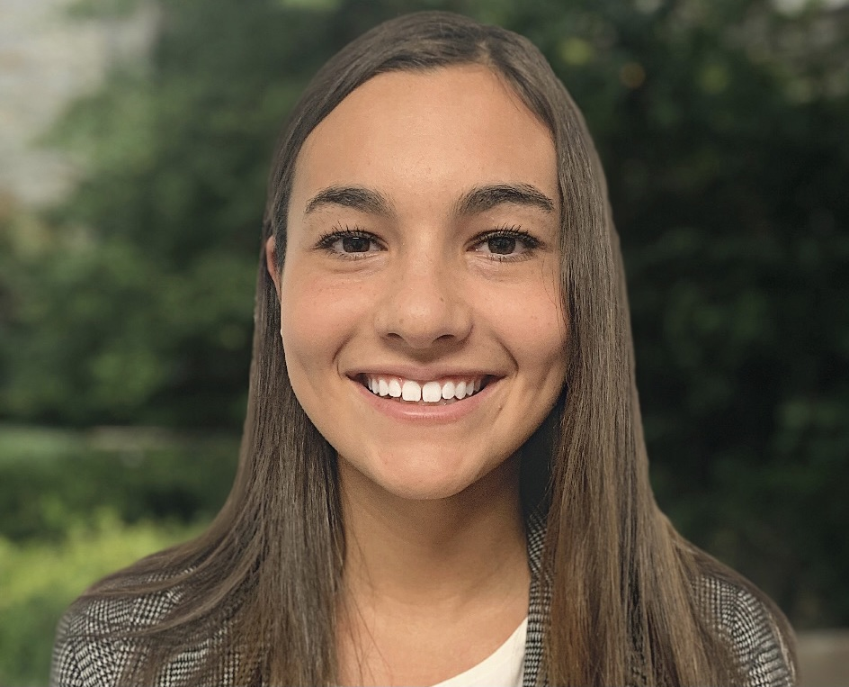
Melina Connolly
Melina is a senior from Massachusetts pursuing an BBA in finance with a minor in information systems. In addition to school, she was a member of the business fraternity at Loyola, Alpha Kappa Psi. She was also a member of FMA, Financial Management Association. Previous internships included being a corporate finance intern at Delta Dental, as well as a corporate financial planning and analysis intern at Hologic. After graduation, she will be going back to Boston, MA, to work at PwC as a deals valuation associate.

Slide 7
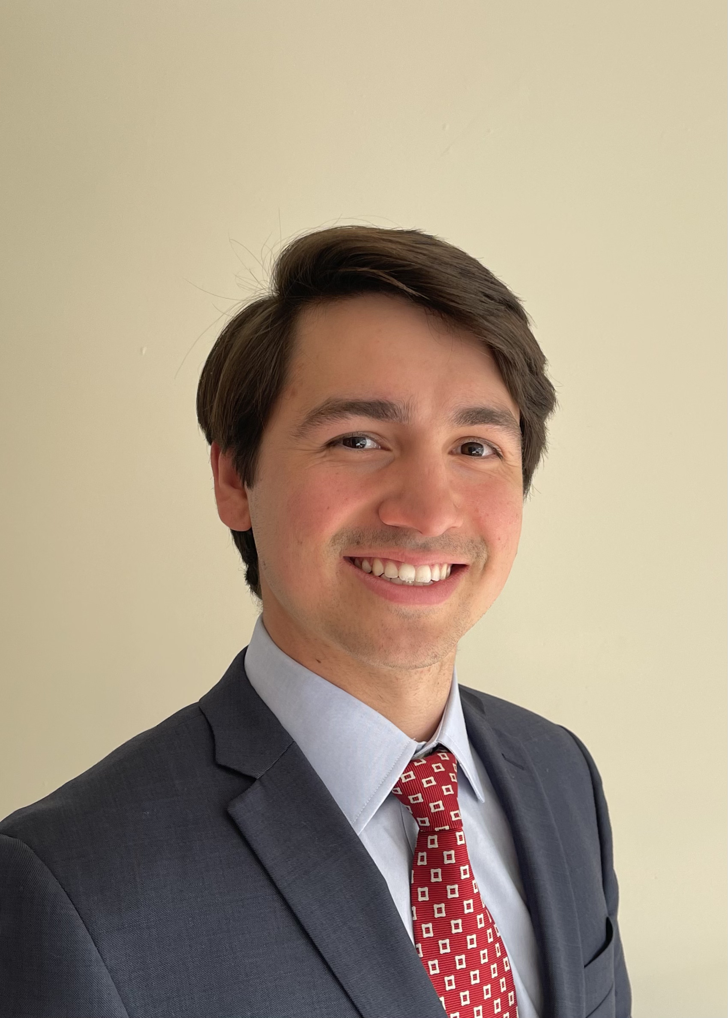
Stephen Curiale
Stephen is an undergraduate student pursuing a Bachelor of Business Administration with a concentration in Finance and a minor in Computer Science at Loyola University Maryland. In addition to his academics, Stephen is the Co-President of the Microfinance Club and a member of the Investment Club. He has interned at Oppenheimer & Co as a Summer Analyst for summers 2019, 2020, and 2021. Following graduation, Stephen will explore opportunities in the New York Metropolitan area and work towards earing his CFA.

Slide 8
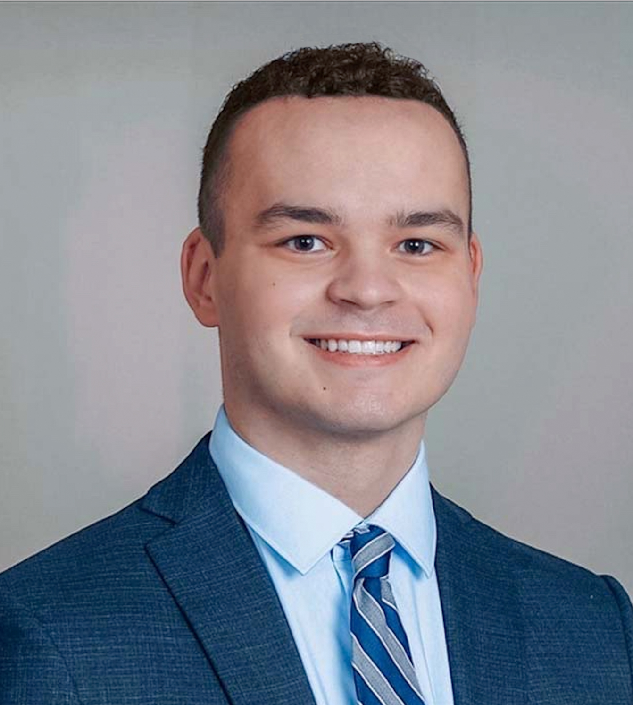
Nicholas Darcy
Nicholas is a senior from Cornwall, New York pursuing a Bachelor’s of Business Administration with a concentration in Finance and a minor in Information Systems. In addition to his studies, Nicholas is a member of the Financial Management Association and a mentor for Student Leadership Corps. He was previously a Member Supervision- Capital Markets intern with FINRA and a Financial Services Intern at Cetera Investors. Upon graduation, Nicholas will be joining KPMG as a Financial Services Regulatory & Compliance Risk associate in New York, NY.

Slide 9
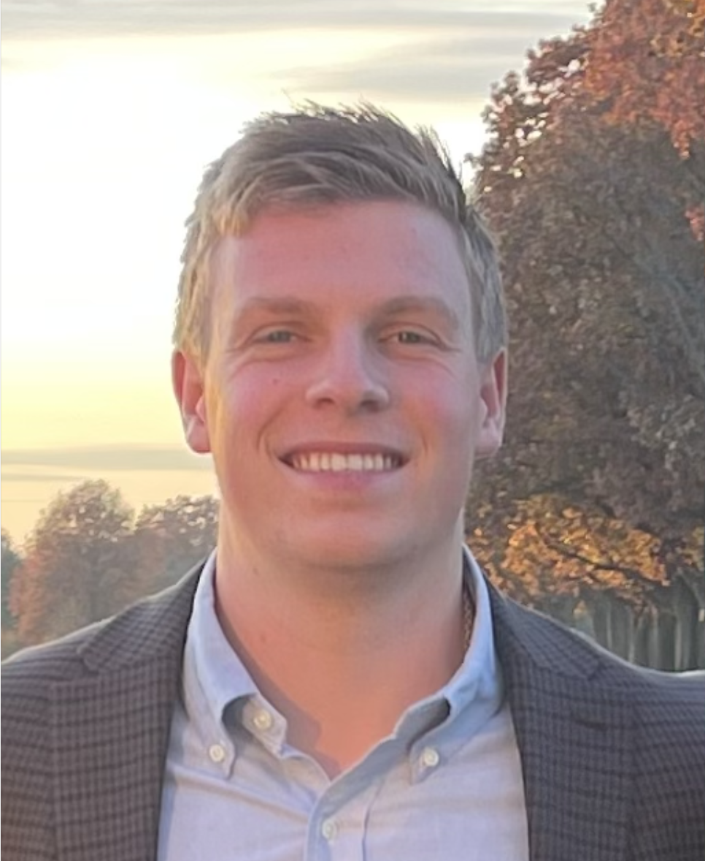
Mark DiPierro
Mark is an undergraduate student pursuing a Bachelors of Business Administration with a concentration in Finance and a minor in Information Systems at Loyola University Maryland. In addition to his studies, Mark is a four-year member and current Vice President of the Club Baseball Team. He as well volunteers with the UMBC Division 1 Baseball Program as Co-Director of Analytics. Following graduation, Mark will return home to New York and will start his career with JPMorgan Chase in the Global Private Bank as a Private Bank Analyst.

Slide 10
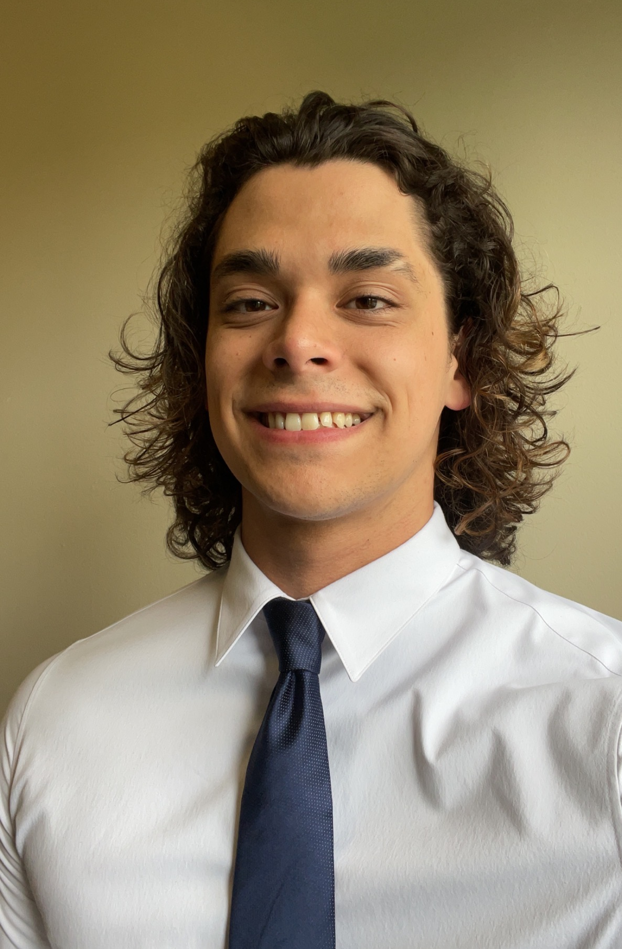
Roderick Fernandez
Roderick is an undergraduate student pursuing a Bachelor of Business Administration with a concentration in Finance. In addition to his studies, he also was a part of many on campus extracurricular clubs such as being co-president of the Investments club along with founding and being president of the Loyola Barbell club. While not in class he enjoys spending time with friends and classmates along with lifting weights and giving free training sessions to barbell club members. Upon graduation, Roderick is taking a gap year before returning to Loyola to pursue his master's in Business Administration.

Slide 11
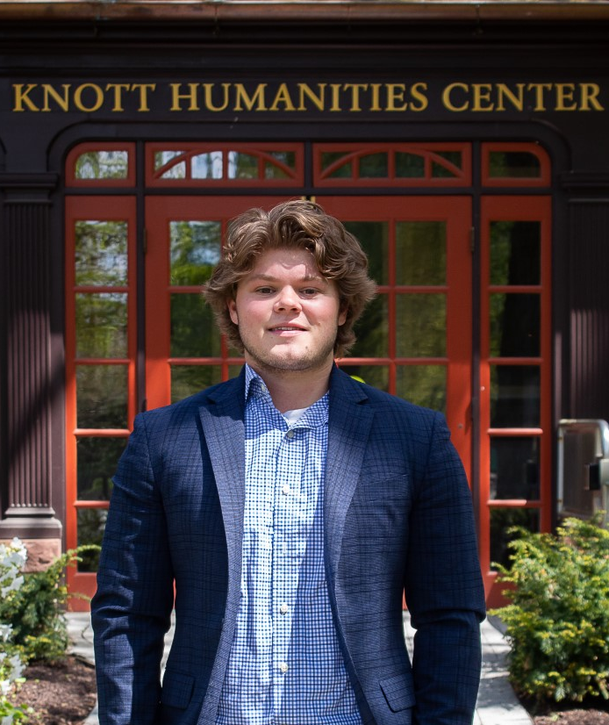
Cameron Hall
Cameron is an undergraduate student pursuing a Bachelor of Business Administration with a concentration in Finance and a minor in Information Systems from Loyola University Maryland. In addition to his studies, he is the co-president of the Investment Club and a member of the Loyola Club Rugby team. Over the past summer, Cameron interned at Crown Castle Fiber in the Credit & Collections Analyst department. While not in class he enjoys spending time with friends, family, and teammates and going to the beach in Maine during the summer. This summer, Cameron will be interning at Bottomline Technologies in the Accounting/Finance department. He will be graduating next December and hopes to pursue his Master's in Business Administration.

Slide 12
Sung Je Lee
Sung Je is an undergraduate student pursuing a Bachelor of Business Administration with a concentration in Finance at Loyola University Maryland. In addition to his studies, Sung has been a four-year member of the Loyola men’s Swim Team. Following graduation, Sung Je will stay in Baltimore and start his career at Transamerica as a GIC Analyst.

Slide 13
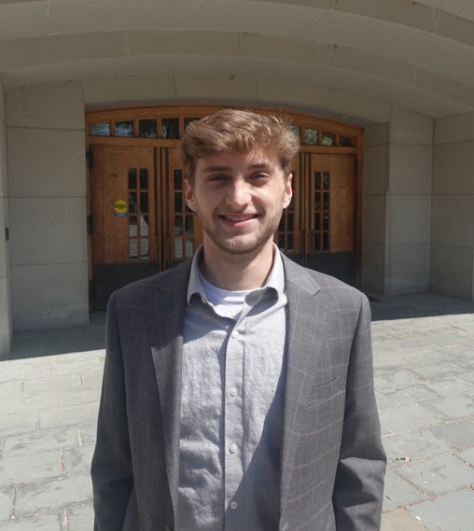
Joshua Long
Josh is an undergraduate student from Boston, MA pursuing his Bachelor’s of Business Administration with a concentration in Finance and Information Systems at Loyola University Maryland. Co-President of the Microfinance Club, Josh has is also a member of the Sellinger Scholars, Alpha Iota Delta, club soccer team, and worked with the Admissions program at Loyola. He has spent his last two years working at Knollwood Investment Advisory as an Investment Analyst Intern where he will transition into a full-time position after graduation.

Slide 14
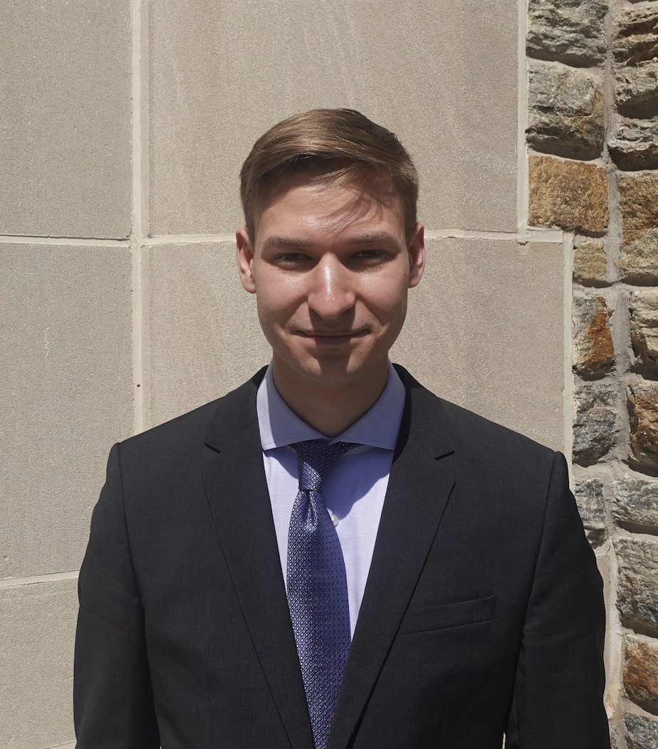
Dominik Pajor
Dominik is an undergraduate student from Westport, CT pursuing a Bachelor of Business Administration with a concentration in Finance at Loyola University Maryland. On campus, he serves as president of the Gearhounds Car Club and member of the Investment Club. He has previously interned with FBN Securities as a Sales & Trading intern, and Dynamic Blockchain Solutions as a Market Research intern. Upon Graduation, Dominik will be working with Northrop Grumman out of Linthicum, MD.

Slide 15
Nicklaus Palmesano
Nicklaus is a senior from Fort Lauderdale Florida pursuing a BBA in Finance with a minor in Communications. In addition to academics, he is a member and treasurer of the Rugby Team and President of the Club Golf Team. Over the summer he had an internship with Northwestern Mutual as a sales associate and has plans after graduation to sit and take the CFA Level 1 exam. After college Nicklaus will be working at Merrill Lynch out of Fort Lauderdale in wealth management.

Slide 16
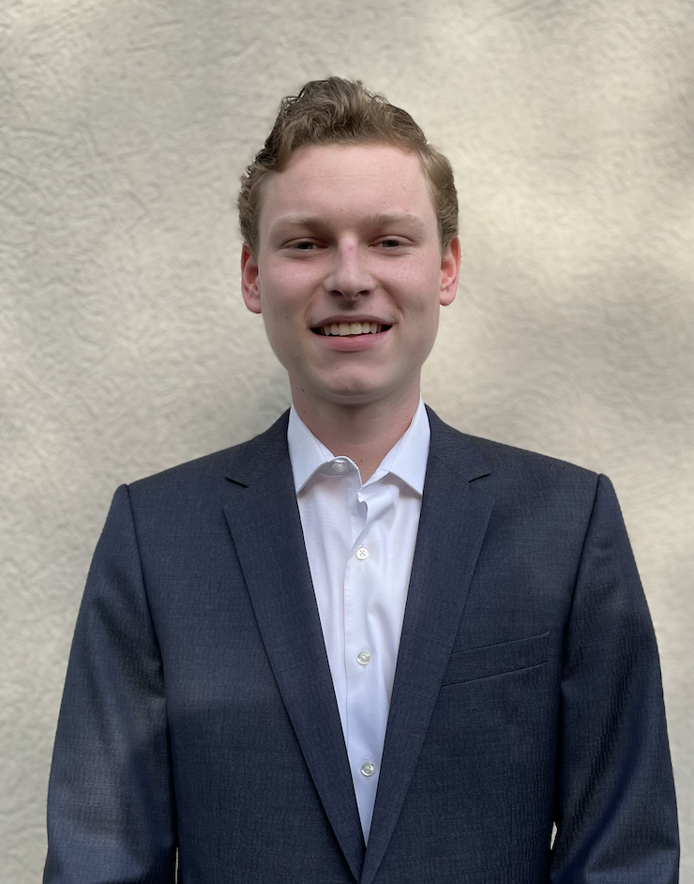
Christopher Quinn
Christopher is a senior from Wyckoff, NJ pursuing a Bachelor of Business Administration with a concentration in Finance from Loyola. In addition to school, he was a member of the investment club and barbell club while here at Loyola. In his free time, Christopher enjoys playing basketball with his friends, skiing, and watching his favorite sports teams. Following graduation, Christopher will be working in New York City full-time as a risk consulting associate, where he then hopes to further his career in finance.

Slide 17
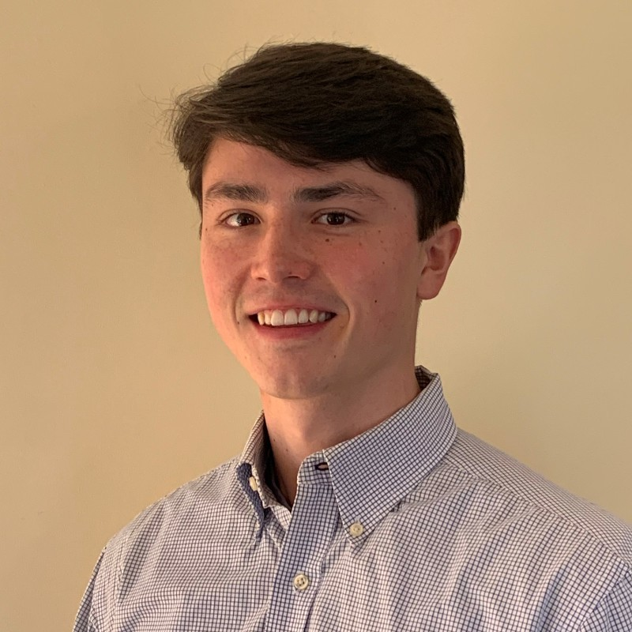
Benjamin Sasse
Benjamin Sasse is a senior from Ridgefield, Connecticut pursing a BBA with a concentration in Finance. In addition to his studies Benjamin is an active member in the Loyola Investment Club. This summer he has a position as a financial services intern at Centennial Bank. Benjamin has one more semester and will graduate in December 2022. Upon graduation he is pursuing a career as a financial planner.

Slide 18
Aidan Serkes
Aidan is an undergraduate student pursuing a Bachelor of Business Administration with a concentration in Finance and a minor in Information Systems from Loyola University Maryland. Aidan is a member of the Micro Finance Club and held an internship at Greenbird Capital last summer. Following graduation, he will be undergoing a training program to be Financial Advisor with UBS in the Baltimore Area.

Slide 19
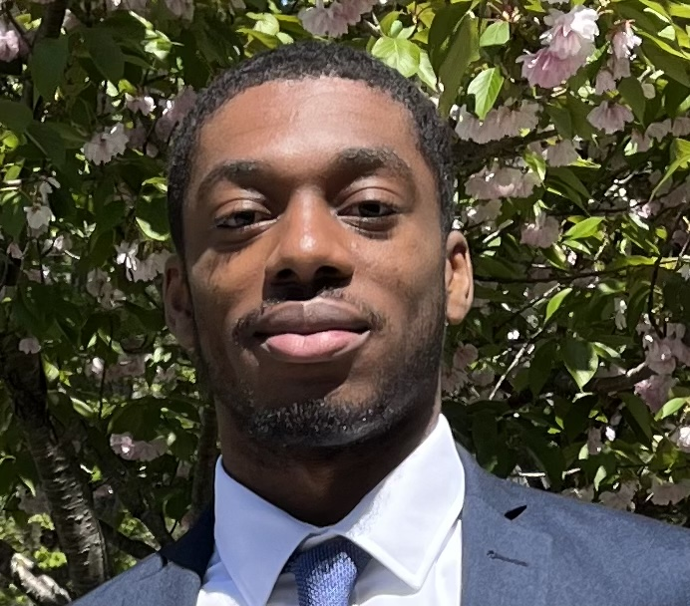
Ethan Smith
Ethan Smith is a senior from Upper Marlboro, Maryland pursing a BBA with a concentration in Finance and a minor in Information Systems. In addition to his studies Ethan is an active member in the Loyola French Club and Pre-Law Society. Ethan will be graduating in May 2022 but will be remaining at Loyola to pursue his Emerging Leaders MBA. Upon completion of his MBA program, he is pursuing a career in wealth management.

Slide 20
Sasha Sparacino
Sasha is an undergraduate student pursuing dual Bachelors of Business Administrations with concentrations in Finance and Information Systems. In addition to his studies, Sasha has been a four-year member of the Loyola Men’s Golf Team, where he is the team’s first ever international student. Furthermore, Sasha is also the President of the Fixed Income Society. Following graduation, Sasha plans to explore opportunities in Dubai and New York in the fields of Investment Banking and Private Equity. Alongside these endeavors, he looks to fund and cultivate a potential Fin-tech Startup.

Slide 21
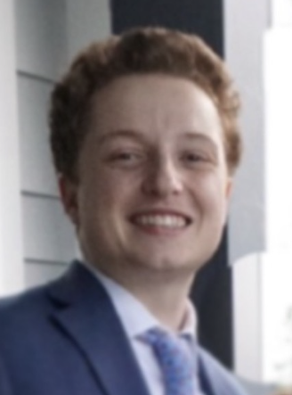
Michael Steinrock
Michael Steinrock is a Finance Major and Information Systems Minor from West Chester Pennsylvania. He is a member of Club Baseball at Loyola and is a member of the Sellinger Scholars Business Honors Society. Upon graduation he is planning on working at Bank of America Merrill Lynch as a Financial Advisor.

Slide 22
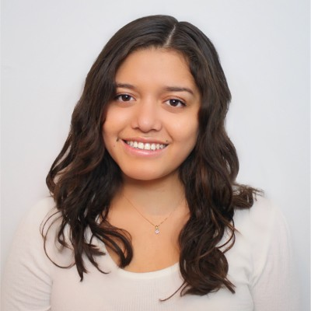
Tiana Tupac-Yupanqui
Tiana is an undergraduate student pursuing a Bachelor of Business Administration with a double concentration in Finance and Economics. In addition to her studies, she worked at the Alumni Office, International student Services, and as a Desk Assistant. Over the past summer, Tiana interned for Pfizer in their Decision Support of Excellence department. Where they provided comprehensive financial reporting, financial support, and guidance to the commercial finance team. In her free time, she enjoys spending time with family and friends, listening to podcasts, and working out. Upon graduation, Tiana hopes to pursue her Masters in Business Administration after graduation

